Slide 1
Adding Unit Tests
Remember this link, has complete walk thru
https://msdn.microsoft.com/en-us/library/ms182532.aspx

Slide 2
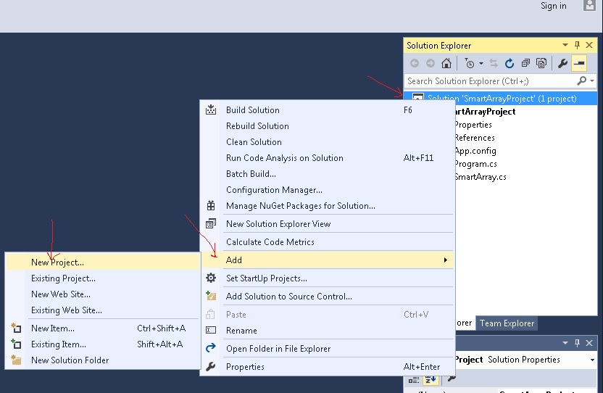
Add a new project to the solution

Slide 3
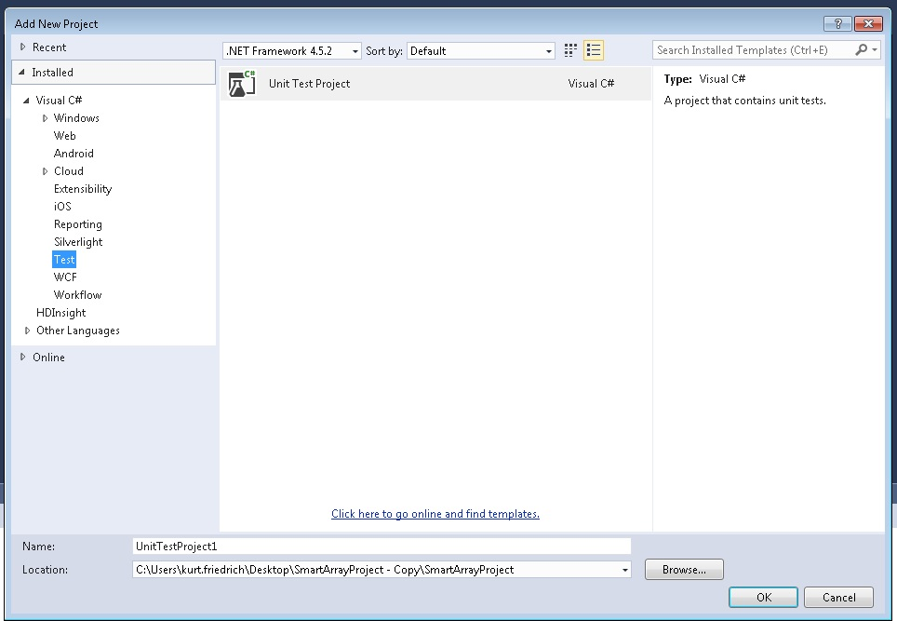

Slide 4
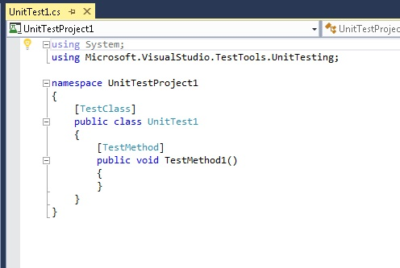
Annotated as a TestClass
Annotated as a TestClass
Any method in the TestClass
With the TestMethod
Annotation will be run.
(other methods can be
there for use by the Test
Methods

Slide 5
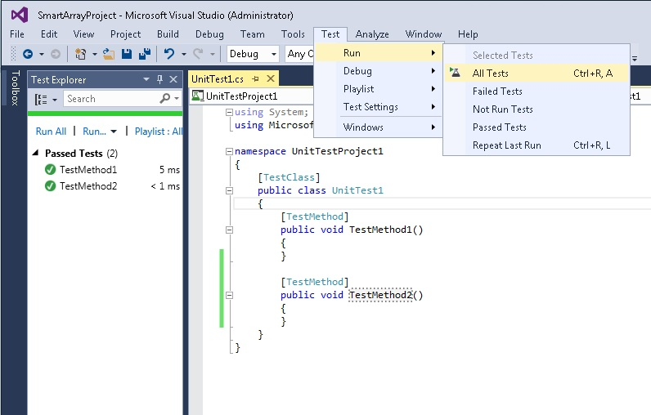

Slide 6
[TestClass]
public class UnitTest1
{
const int SMART_ARRAY_SIZE = 5;
// SmartArray should initialize with all zeros
[TestMethod]
public void ArrayStartWithAll_0s()
{
SmartArray testSmartArray = new SmartArray(SMART_ARRAY_SIZE);
//testSmartArray.SetAtIndex(2, 5); //used to verify test is working
int actual = 0;
for (int i = 0; i < SMART_ARRAY_SIZE; i++)
{
actual = actual + testSmartArray.GetAtIndex(i);
}
// assert
int expected = 0;
Assert.AreEqual(expected, actual, 0.000001, "SmartArray not initilized to all zeros");
}
// SmartArray should allow setting the 0 location
[TestMethod]
public void SetLocation_0()
{
SmartArray testSmartArray = new SmartArray(SMART_ARRAY_SIZE);
testSmartArray.SetAtIndex(0, 5);
// assert
int actual = testSmartArray.GetAtIndex(0);
int expected = 5;
Assert.AreEqual(expected, actual, 0.000001, "Did not set SmartArray loc 0 correctly");
}
}
Set up anything you need to be used by multiple tests
Always comment what the test does
Name test method to indicate what the test does
Set up some conditions …
Create an expected result, and then test for it
The Assert class does all the work of running the code and publishing the results

Slide 7
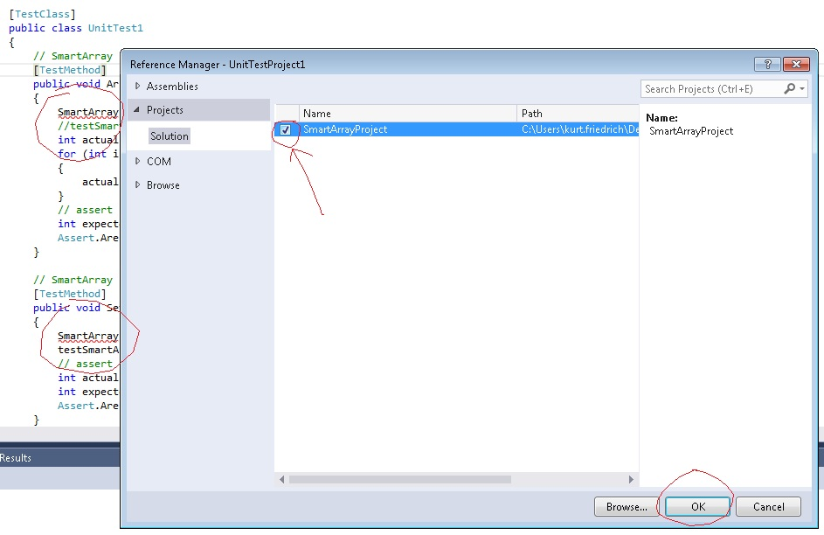

Slide 8
// SmartArray throw exception trying to set location greater than size of array
[TestMethod]
[ExpectedException(typeof(IndexOutOfRangeException))]
public void SetLocationAtSizeOfArrayValue()
{
SmartArray testSmartArray = new SmartArray(SMART_ARRAY_SIZE);
testSmartArray.SetAtIndex(SMART_ARRAY_SIZE, 15);
// assert is handled by ExpectedException
}

Slide 9
Writing your own tests
Assert.AreEqual
Assert.IsFalse
Type Assert. And see all the methods available, and when you pick one, Intellisense will show you the needed calling pararmeters
[ExpectedException(typeof(IndexOutOfRangeException))]
Also, always test your test by trying it with a “broken” value to make sure your test case is actually working

Slide 10
Write tests for these other cases
SmartArray should initialize with all zeros (we did this one)
SmartArray should allow setting the 0 location (we did this one)
Can add value to all locations in SmartArray
SmartArray throw exception trying to set location 15 (we did this one)
SmartArray throw exception trying to set negative location
SmartArray should allow finding value
SmartArray not find value that is not there
SmartArray should allow taking an array of size 5 to 10
SmartArray should preserve the values when taking an array of size 5 to 10
SmartArray should allow taking an array of size 10 to 5
SmartArray should preserve the values when taking an array of size 10 to 5
Please note that when testing for array size changes, you should test that values that were in the array are preserved. Testing loc [0] and [4] would be sufficient. Also make sure the array really is the length it is supposed to be after the change.

